Slide 1

CURRENCY CONVERTER (A mini Core Java Project)
By
RENU SHARMA

Slide 2
Currency
A system of money in general use in a particular country.
Currency is a medium of exchange for goods and services. In short, it's money, in the form of paper and coins, usually issued by a government and generally accepted at its face value as a method of payment.
Currency is the primary medium of exchange in the modern world, having long ago replaced bartering as a means of trading goods and services.

Slide 3

CONVERSION
The act or process of converting; state of being converted.
Change in character, form, or function.
In Financial terms
an exchange of one kind or class or security for another
an exchange of a currency for an equivalent amount of another currency or precious metal.

Slide 4
CURRENCY CONVERTER
The conversion of exchange rates of one country’s respective prevailing currency with the other
An exchange rate is how much it costs to exchange one currency from another. As currencies around the world are constantly being traded (bought and sold), the exchange rate tend to change from week to week.
Currency Converter is an app or web tool that allows for the quick conversion of any currency into any other currency.

Slide 5
METHODS
double
double is used to represent floating-point numbers.
Decimal Format
Java has a special class called DecimalFormat that is used to format the numbers. This formatting is customizable.
DecimalFormat is a concrete subclass of NumberFormat that formats decimal numbers.
It has a variety of features designed to make it possible to parse and format numbers in any locale, including support for Western, Arabic, and Indic digits

Slide 6
Scanner
Scanner is a class in java.util package used for obtaining the input of the primitive types like int, double, etc. and strings.
It is the easiest way to read input from keyboard in a Java program.

Slide 7
If/else
Use if to specify a block of code to be executed, if a specified condition is true.
Use else to specify a block of code to be executed, if the same condition is false.
else if
Use else if to specify a new condition to test, if the first condition is false.

Slide 8
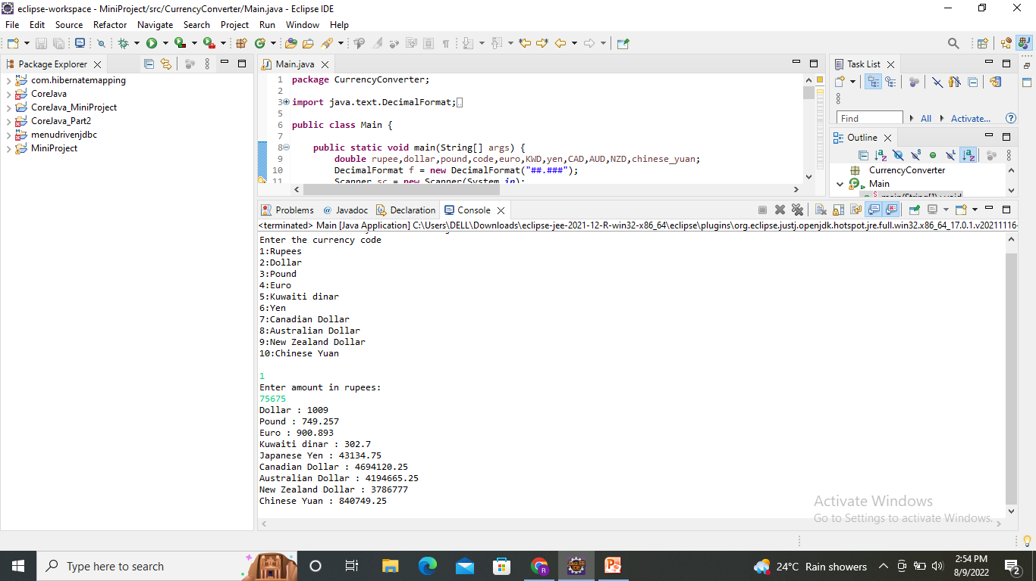
Output

Slide 9
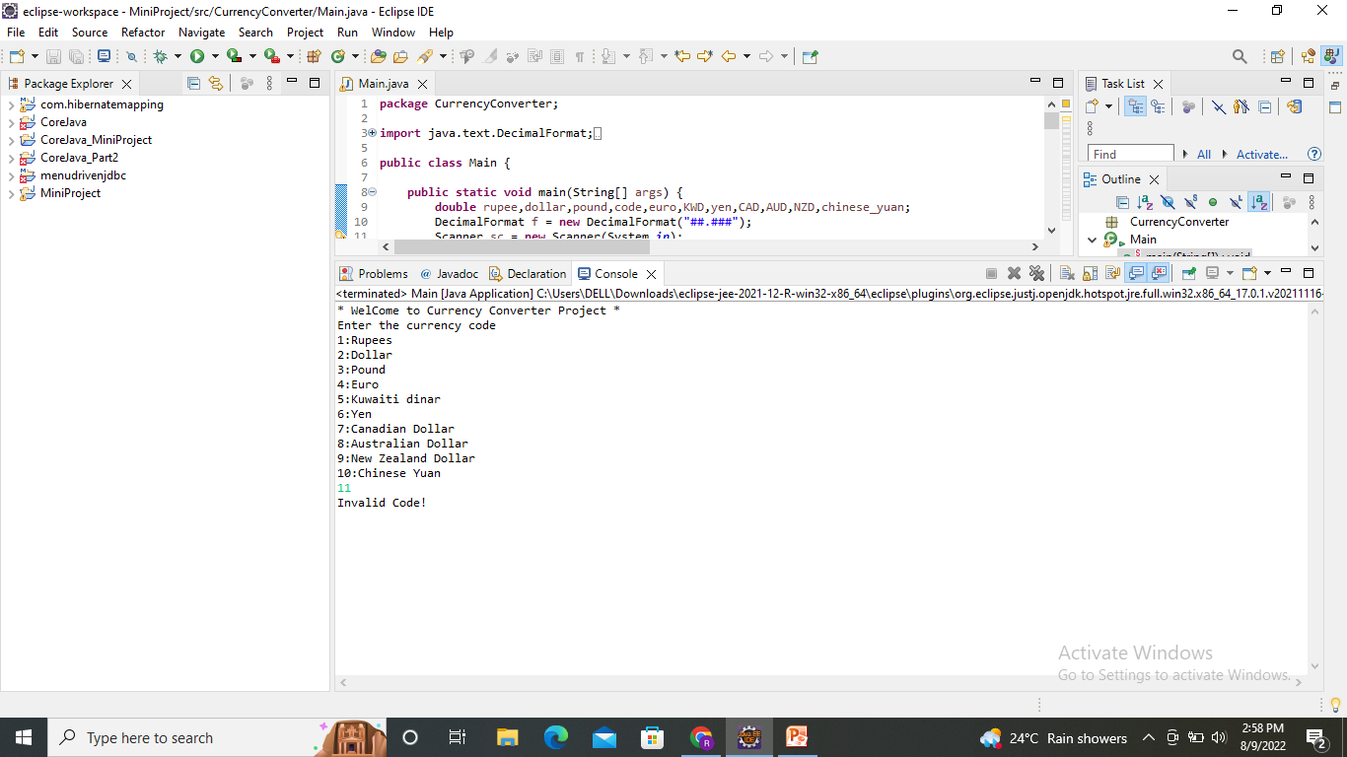

Slide 10
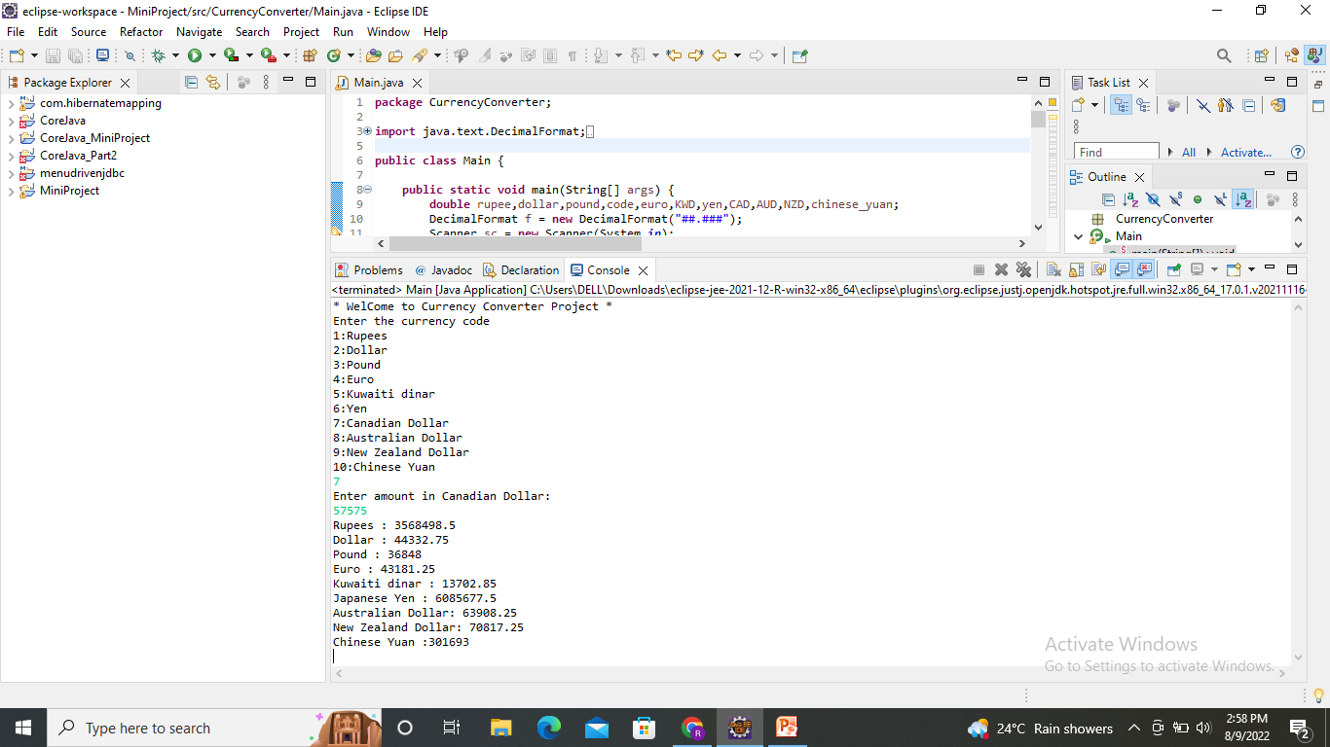

Slide 11
Thank you

